Slide 1

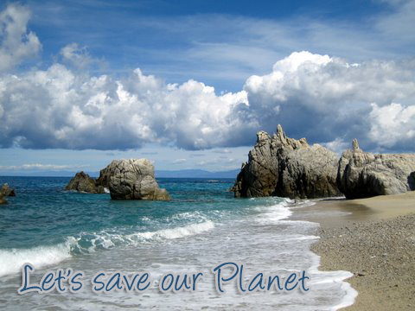

Slide 2
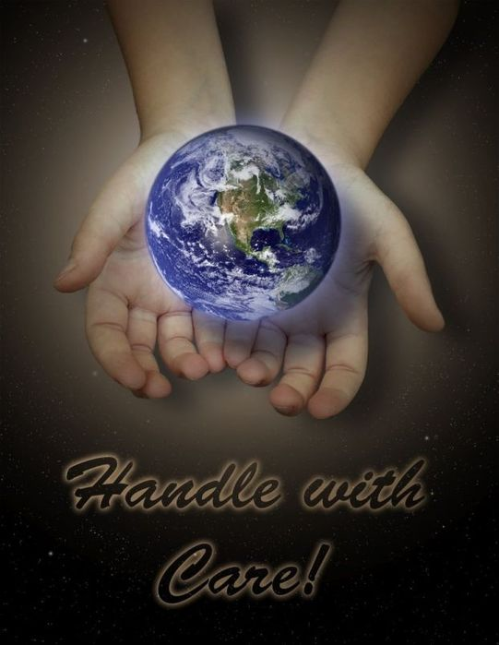
contents
Beautiful planet
What do you see?
problems
House effect
Pollution
Stop using plastic bags
Save water
Forests

Slide 3
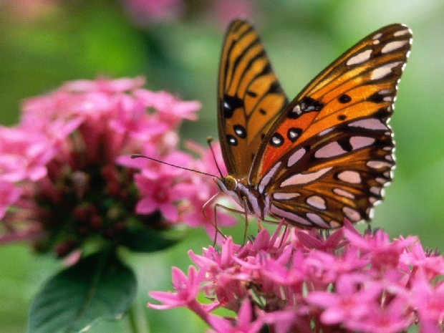
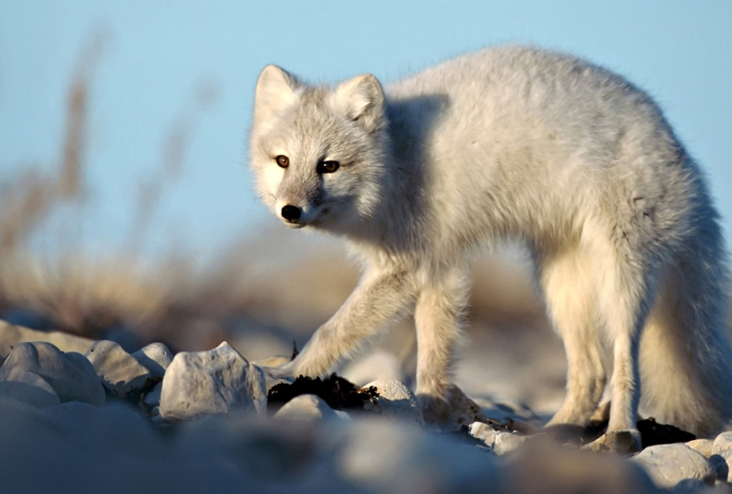
beautiful planet
We live on a beautiful planet. There are a lot of magnificent creatures on it. Different species of mammals, reptiles, birds and flowers surround us. But humans don`t note them.

Slide 4
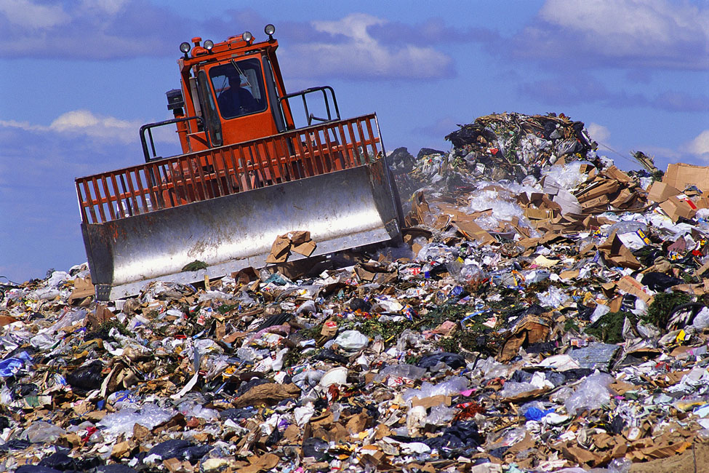
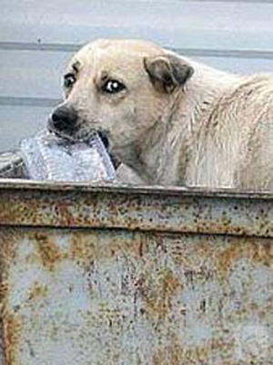
What do you see?
Look out of the window! What do you see? Dark constructions, dirty streets, stray dogs, many dumps. I can`t think that the human makes our planet such terrible! Humans destroy our planet.

Slide 5
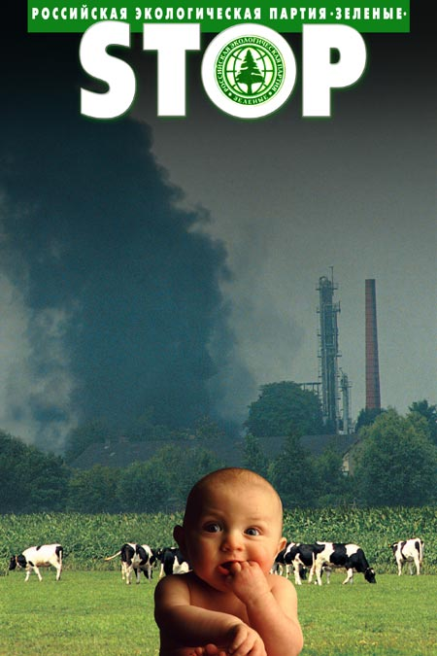
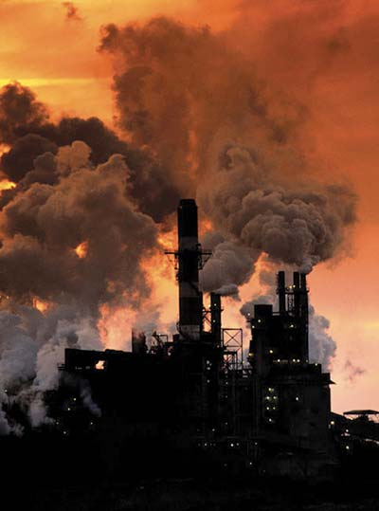
problems
Nowadays people must solve such problems as green house effect and pollution.

Slide 6
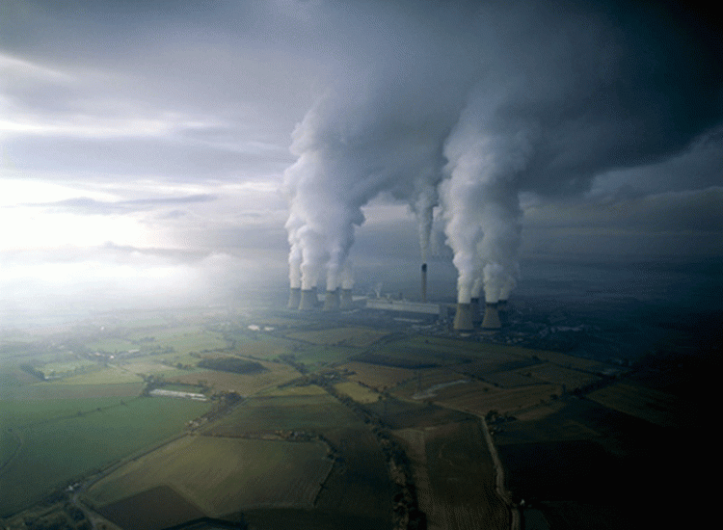
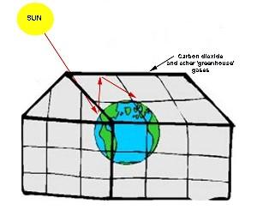
House effect
What do we know about green house effect? Do you know that the temperature in many towns becomes higher? It is so because of green house effect. Atmosphere surrounds our planet. Sunlight warms the atmosphere and can`t go back into space.

Slide 7
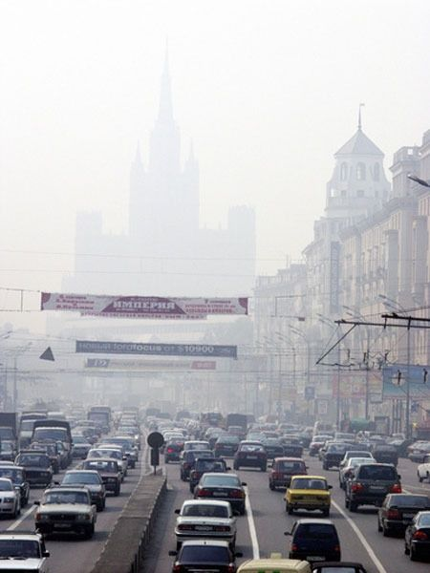
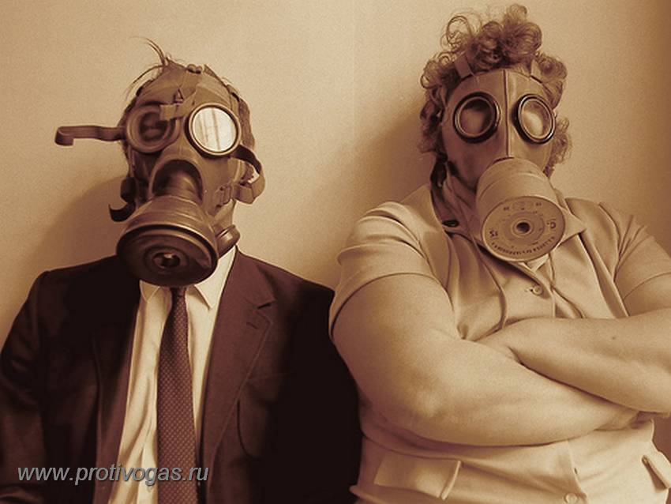
Pollution
And what do we know about pollution? At first, people will be healthier if pollution of curs stops. Secondly, if different countries test nuclear weapons, it will cause radioactive pollution. And if factories merge waste in rivers, water will be poisoned in those ones.

Slide 8

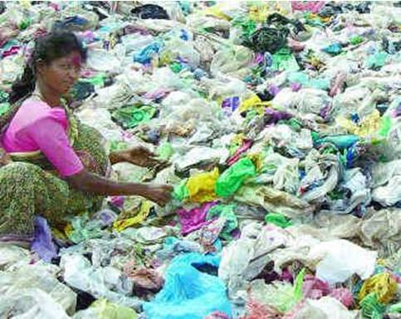
Stop using plastic bags
People utilize 4 trillions of packages a year.
In the environment the thrown out packages are being saved for long time and not exposed to biological decomposition.

Slide 9
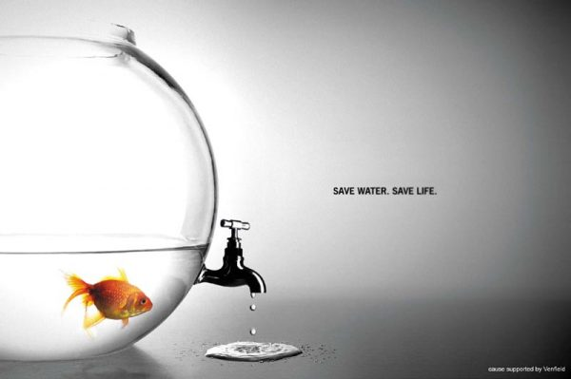
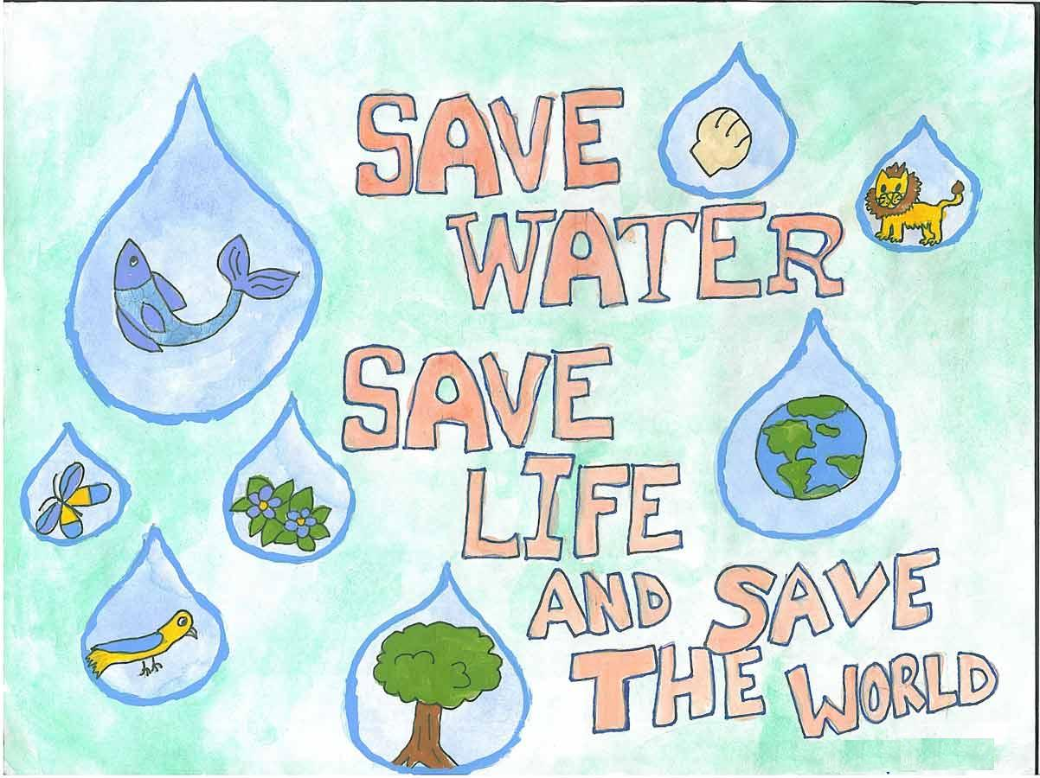
Save water
Nearly 1 million people don't have access to clean, safe drinking water.
Drinking-water is badly getting worse and less on the Earth.

Slide 10
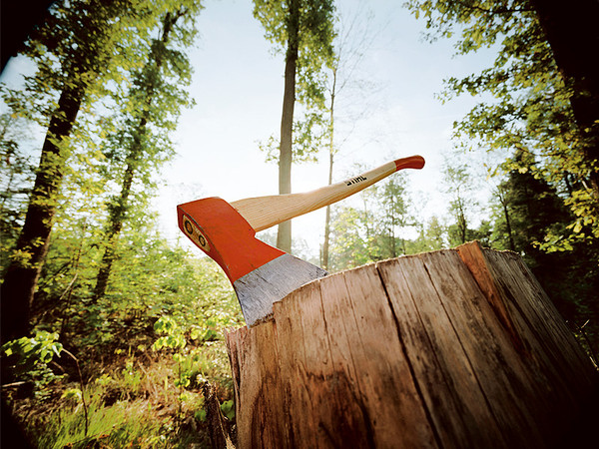
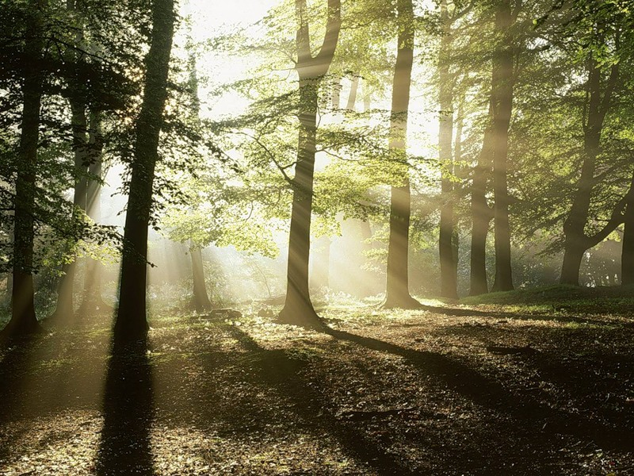
Forests
Today the volume of the forests’ felling exceeds quite often in once or twice the volume of natural renewal.

Slide 11
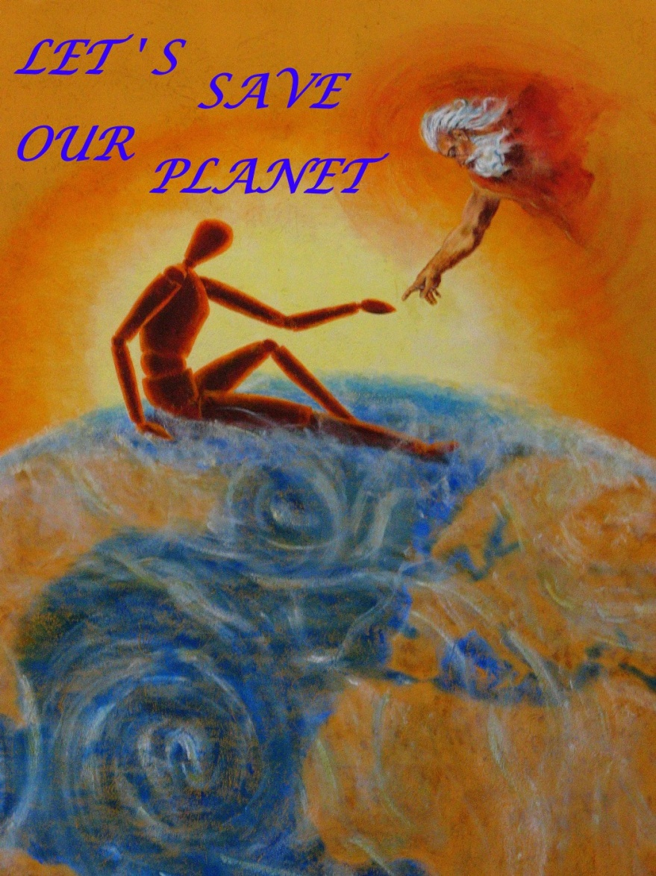
Conclusion
People! Let`s keep our planet! Let`s keep our animals and plants! If we decide ecological problems, we will save our beautiful planet.

